Slide 1

BT1010 Introduction to Life Sciences
Lecture 5: Techniques used in cell and molecular biology
and their diagnostic applications
06/11/2025
Course Instructor:
Dr. Gunjan Mehta, Ph.D.
Assistant Professor
Department of Biotechnology
IIT Hyderabad
(M.) +91 70168 96886 Email: gunjanmehta@bt.iith.ac.in

Slide 2
PCR (Polymerase Chain Reaction) to amplify specific segment of DNA (gene)
Agarose Gel Electrophoresis to separate DNA based on molecular weight
DNA Fingerprinting to identify individuals (parent/kids/crime suspects)
SDS-PAGE to separate proteins based on molecular weight
RT-PCR to quantify DNA/RNA copy numbers
Fluorescence Microscopy to visualize cellular processes

Slide 3
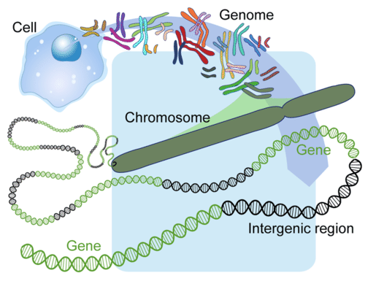
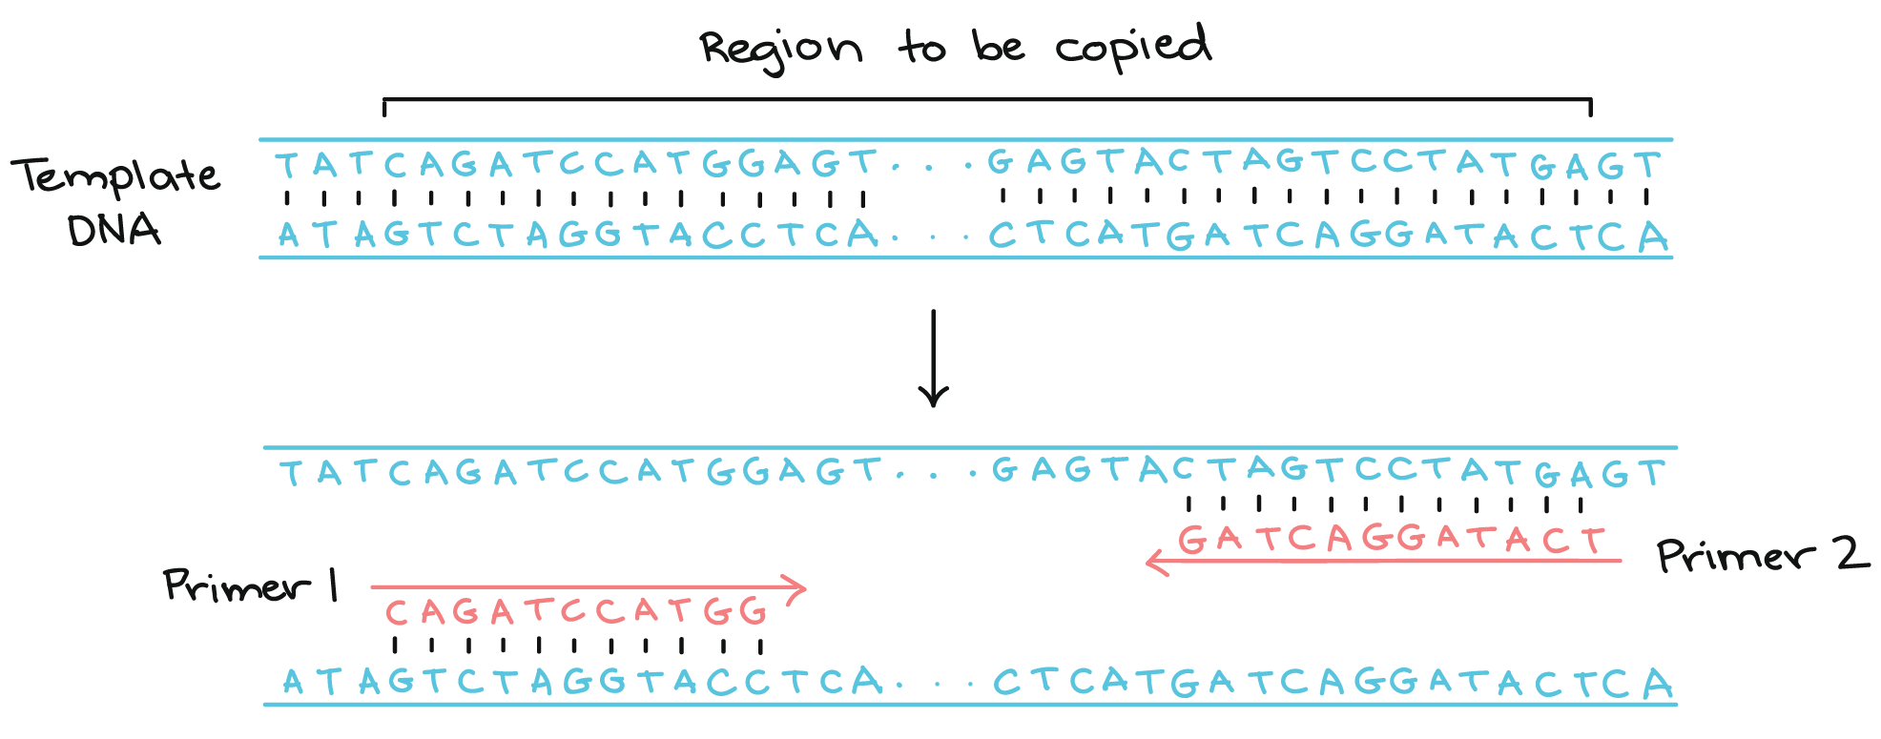
Polymerase Chain Reaction (PCR) to amplify specific gene from the genome
PCR is used to amplify a segment of DNA (gene). It can make thousands of copies of a gene.
DNA is synthesized by an enzyme called DNA polymerase. It synthesize DNA in 5’ to 3’ direction.
5’
3’
3’
5’
5’
3’
3’
5’
Insulin

Slide 4
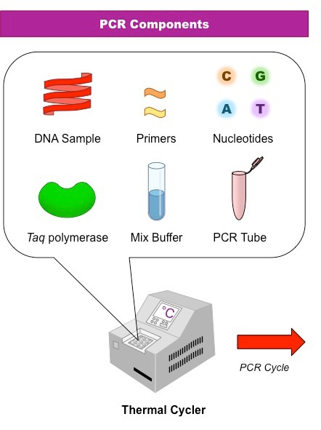
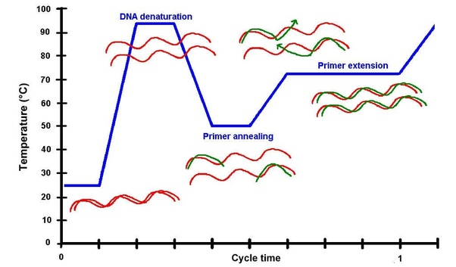
Components of the PCR reaction and amplification cycle
Taq DNA polymerase is thermostable enzyme
Speed of DNA synthesis by Taq DNA polymerase: 2000 bp/min
95 ℃
for 30 s
72 ℃
for 2-3 min
55 ℃
for 30 s
repeated for 30 cycles

Slide 5
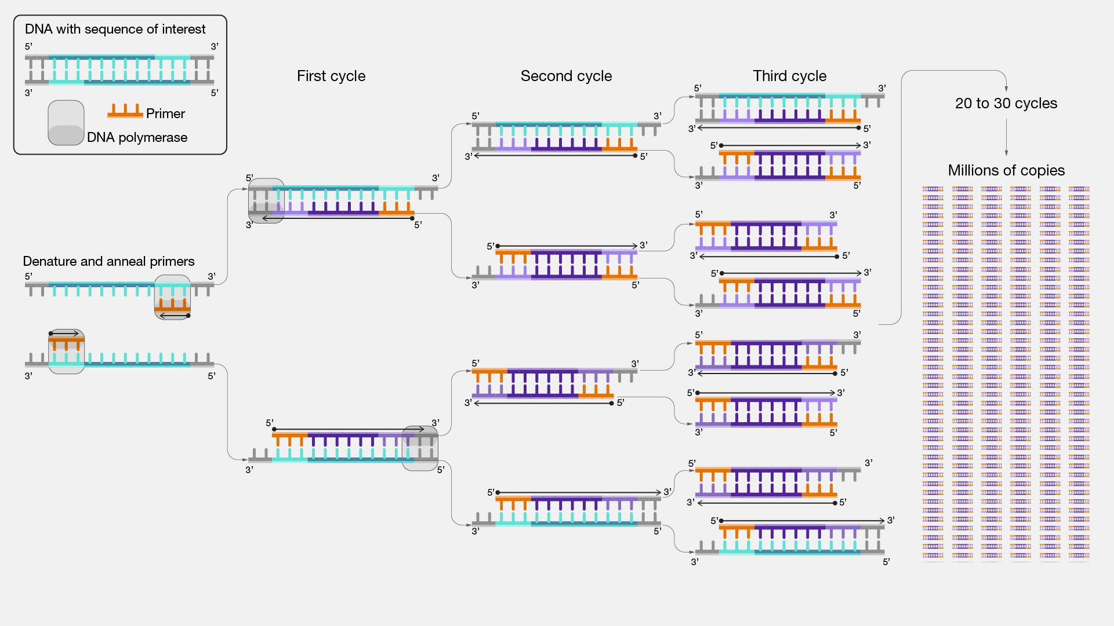
Exponential DNA amplification by PCR
Watch this Youtube video for PCR reaction:
https://www.youtube.com/watch?v=iQsu3Kz9NYo

Slide 6
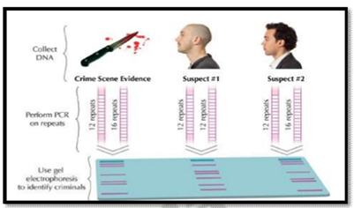
Applications of PCR
Amplify a specific fragment of DNA (a gene) for cloning purposes.
Diagnostic applications to detect bacterial or viral infections.
Forensic DNA analysis to match DNA to criminal suspects. (based on DNA fingerprinting)
Paternity and maternity testing. (based on DNA fingerprinting)
DNA fingerprinting act as a genetic barcode to identify individuals.
Diagnosis of genetic disorders.

Slide 7
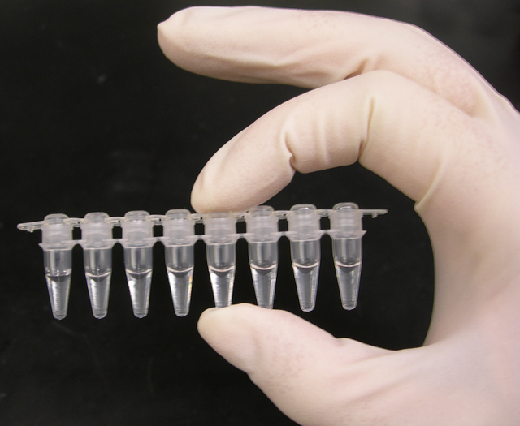
PCR tubes with reaction mixture
Before DNA amplification/
Before PCR reaction
After DNA amplification/
After PCR reaction

Slide 8
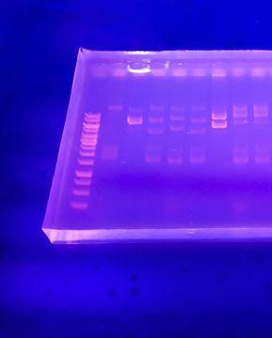
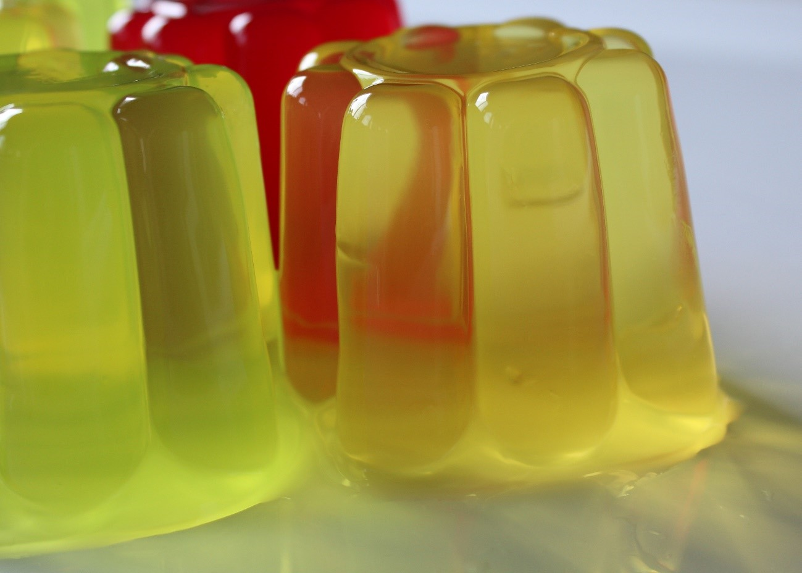
Agarose Gel Electrophoresis to separate and visualize DNA
Ladder
Gelatin gels that we eat
-Ve
1 2 3 4 5 6 7 8 Samples
large DNA
Electric field
small DNA
+Ve
UV light

Slide 9
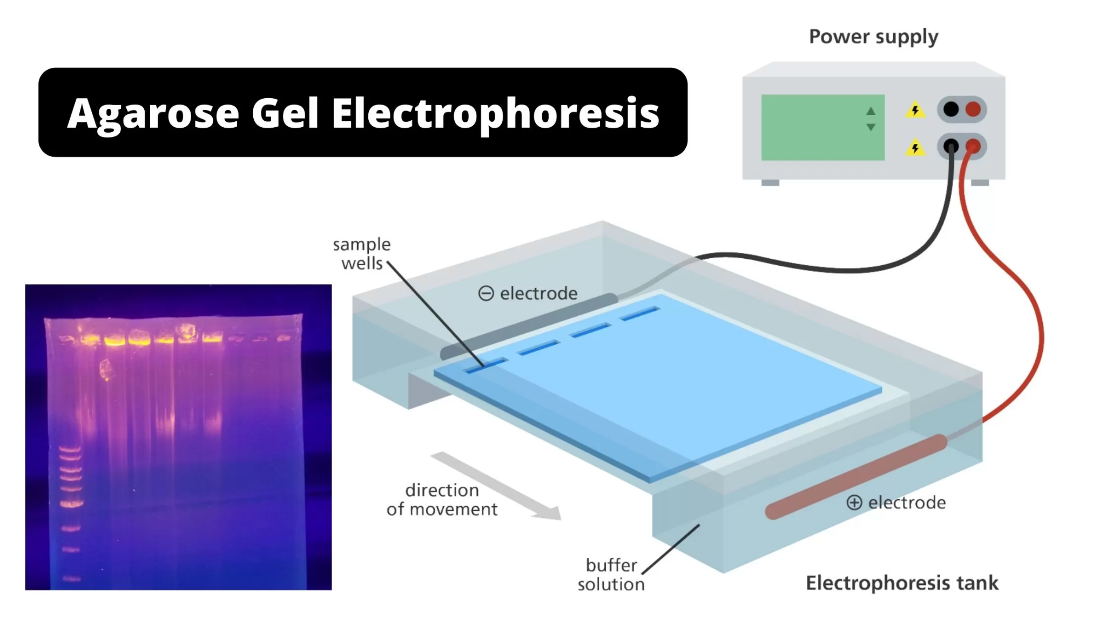
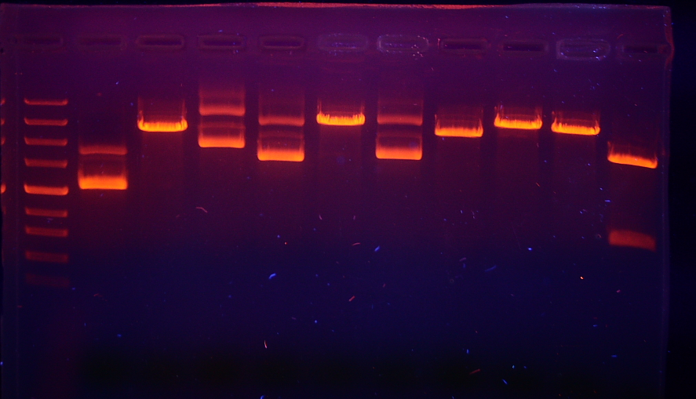
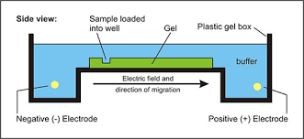
Agarose Gel Electrophoresis to separate DNA
Agarose gel electrophoresis is a method to separate a mixed population of DNA, based on their sizes (molecular weight).
Agarose gel is a 3D matrix, in which the mixture of DNA is loaded and the electric field is applied.
DNA migrates from negative to positive electrode and the distance it migrates depends on the size of the DNA. Small DNA molecules (e.g. 300 bp) moves faster, compared to large DNA molecules (i.e. 1000 bp).
The agarose gel is stained with ethidium bromide (EtBr) and observed under the Ultraviolet light to see the bands of DNA.
DNA molecular weight marker (DNA ladder) is used as a reference of molecular weight.
Sample 1
Sample 2
Sample 3
Sample 4
Sample 5
Sample 6
Sample 7
Sample 8
Sample 9
ladder
Sample 10
-
+

Slide 10
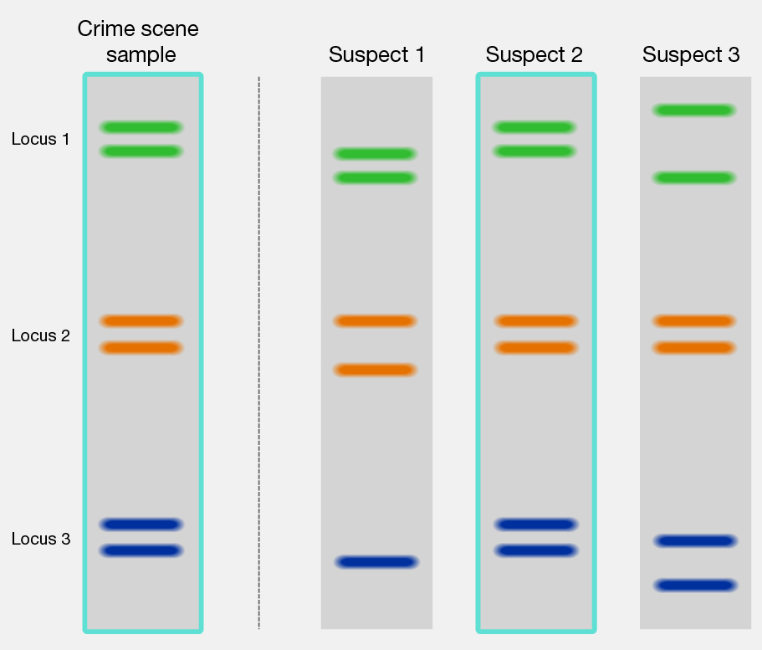
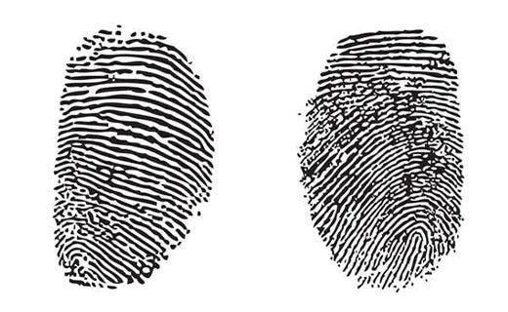
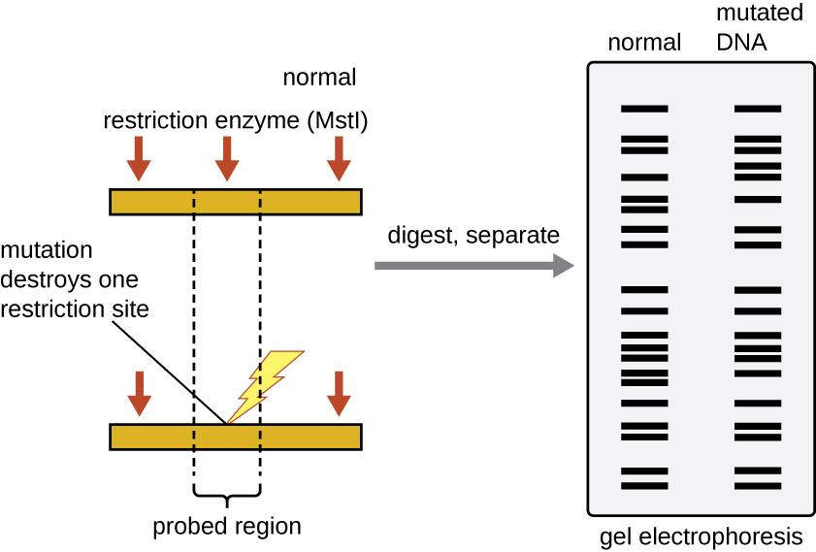
DNA Fingerprinting/RFLP (Restriction Fragment Length Polymorphism)
DNA Fingerprinting is a method in which specific DNA sequences are amplified from the whole genome by PCR, followed by restriction digestion and agarose gel electrophoresis to visualize the fragmentation patterns to identify individuals.
DNA Fingerprinting is also called Restriction Fragment Length Polymorphisms (RFLPs) Analysis and Random Amplified Polymorphic DNA (RAPD).
For DNA Fingerprinting, microsatellite DNA is amplified using PCR from the genome. The number of repeated segments within a microsatellite sequence often varies among people, which makes them useful as polymorphic markers for studying inheritance patterns in families or for creating a DNA fingerprint from crime scene samples.
DNA fingerprinting has four main steps:
Step 1: DNA extraction from cells.
Step 2: PCR to amplify the extracted DNA.
Step 3: Restriction enzyme treatment to cut the DNA at specific sequences, resulting
in fragments that are unique in size to each person.
Step 4: Gel electrophoresis to separate these DNA fragments by size for comparison.
Fingerprints
DNA Fingerprints

Slide 11
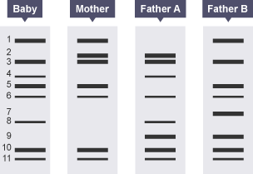
Identify the father of this baby from this DNA Fingerprinting Gel

Slide 12
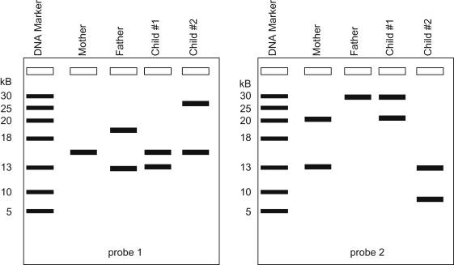
Identify the real child of these mother and father from this DNA Fingerprinting Gel

Slide 13
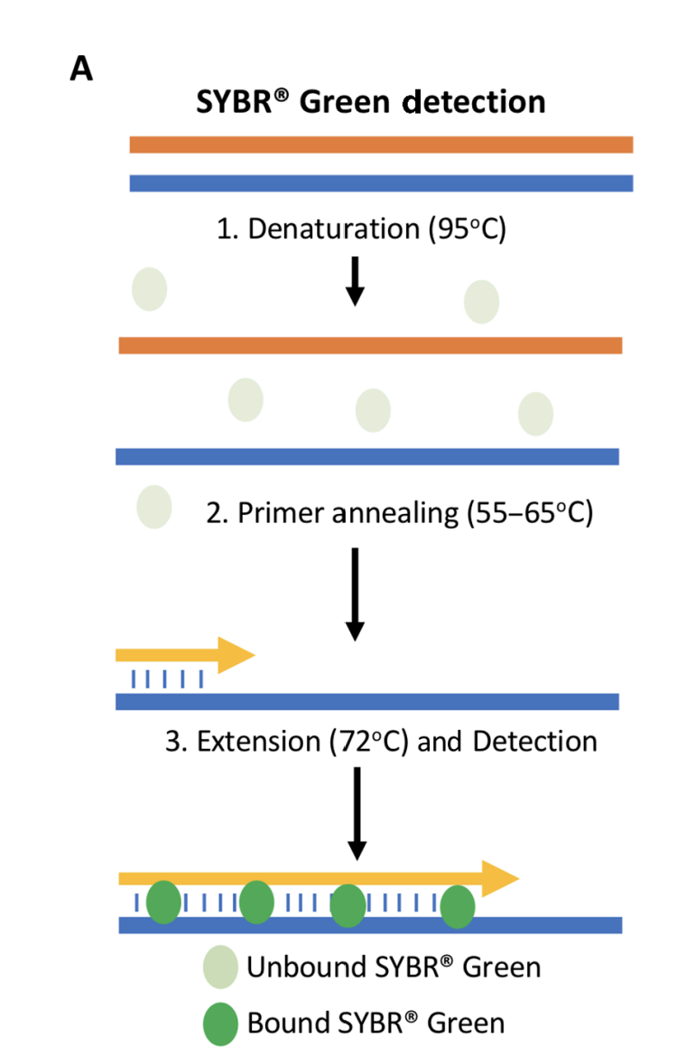
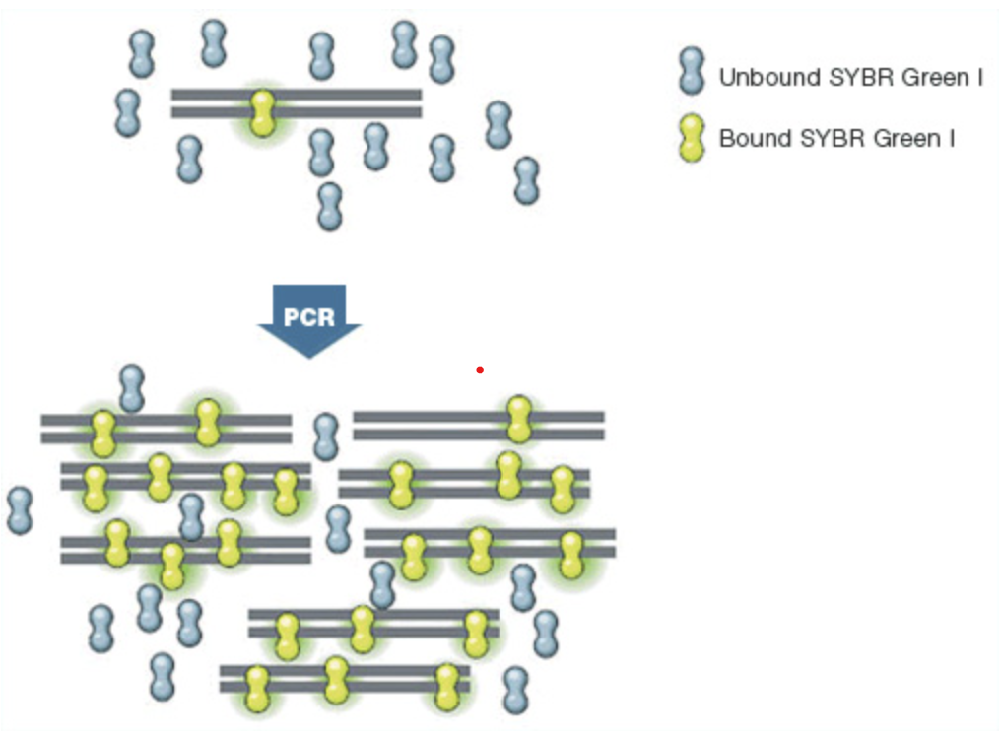
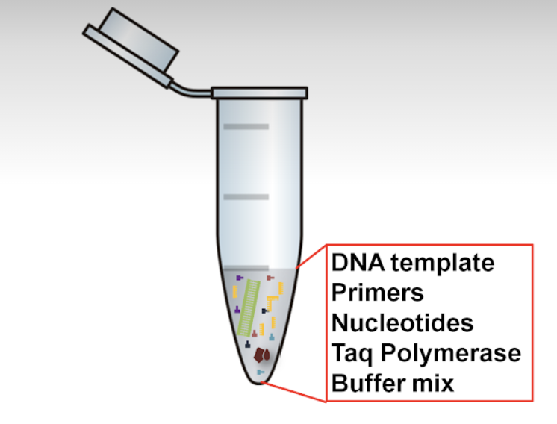
Real-Time PCR (RT-PCR) or Quantitative PCR (q-PCR)
RT-PCR or qPCR: It is performed in the same way as PCR, however, a fluorescent dye is added to the tube that gives fluorescence proportional to the amount of double stranded DNA in the tube. So, the quantify of the double stranded DNA is measure in real-time while the PCR is going on.
This technique is used to quantify the number of DNA molecules present in the tube/sample.
+
Syber green

Slide 14
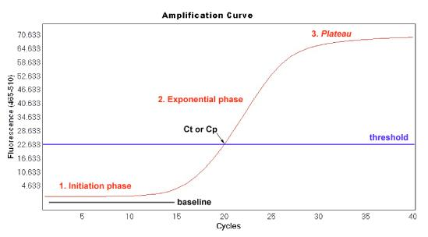
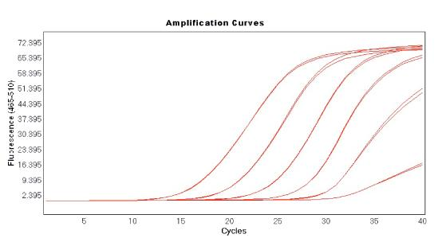
Phases of a RT-PCR amplification curve
Amplification curve obtained from serial dilutions of a target DNA
More initial target
Ct value
Less initial target
Ct value (Critical Threshold Value): It is the number of PCR cycle at which the fluorescence intensity of SyBR green dye became so high that the detector can see green fluorescence in the tube.

Slide 15
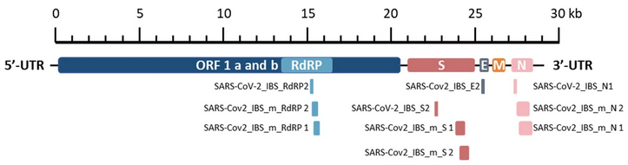
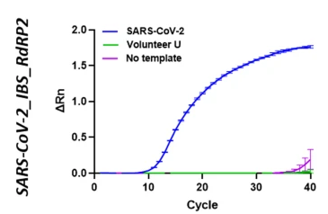
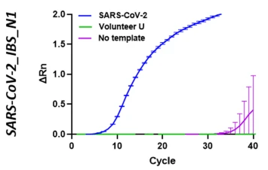
RT-PCR for Covid19 detection
Genome of Covid19 virus

Slide 16
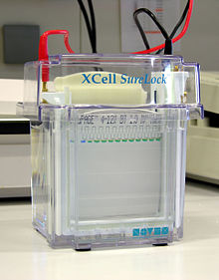
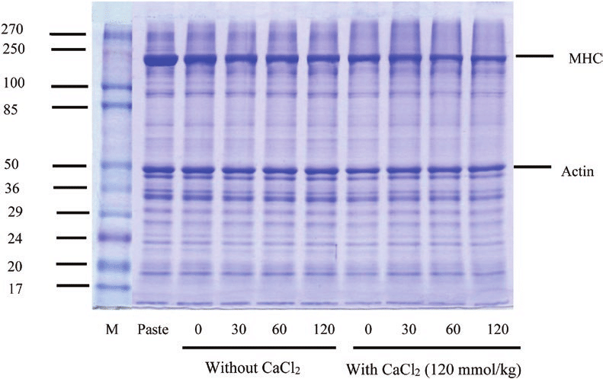
Polyacrylamide Gel Electrophoresis to separate proteins (SDS-PAGE)
SDS-PAGE or Sodium Dodecyl Sulphate-PolyAcrylamide Gel Electrophoresis is a method used for separation of proteins based on their molecular weight.
SDS imparts negative charge to the proteins.
Gel is made up of Polyacrylamide and protein mixture is loaded on the top.
Electric field is applied, so the proteins migrate from negative to positive direction. The smaller proteins migrate faster compared to the larger proteins.
-Ve
+Ve

Slide 17
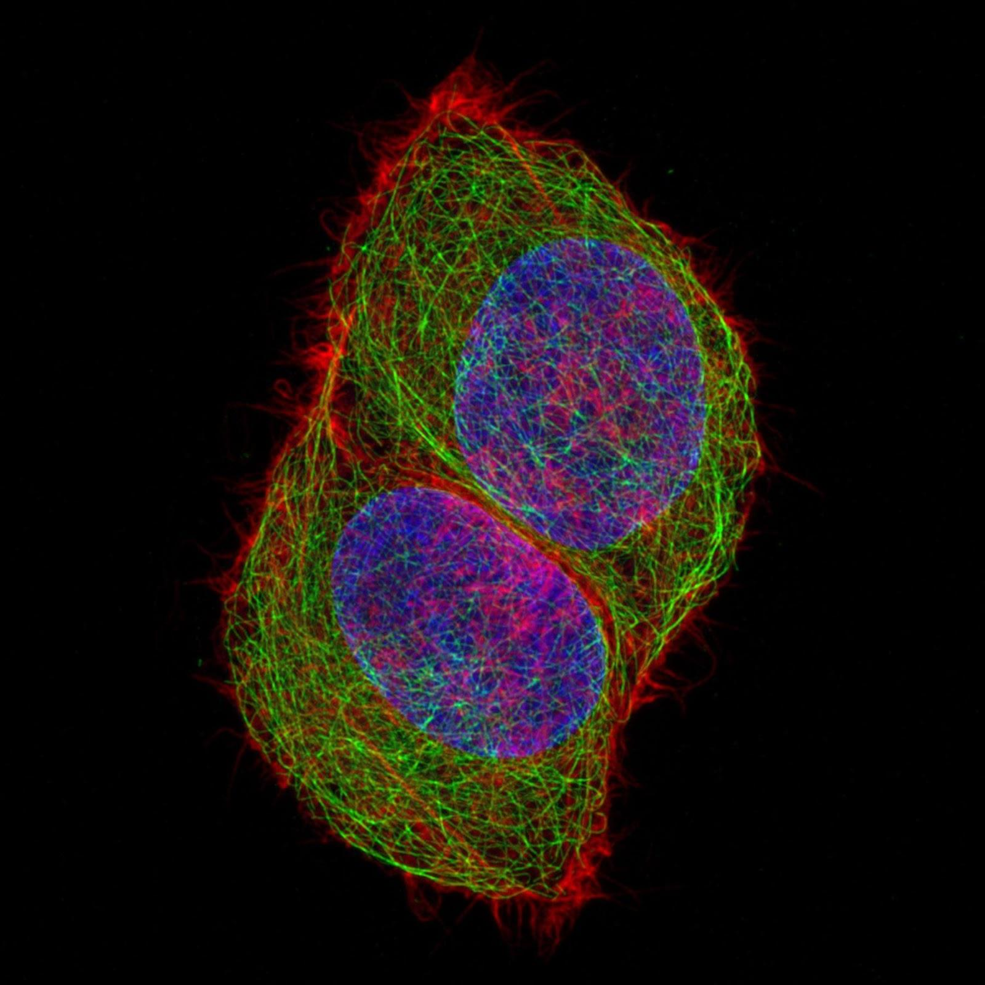
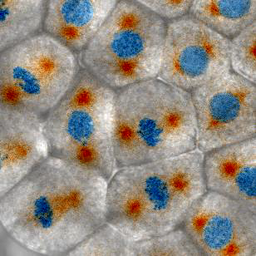
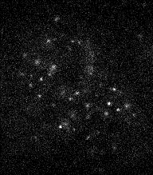
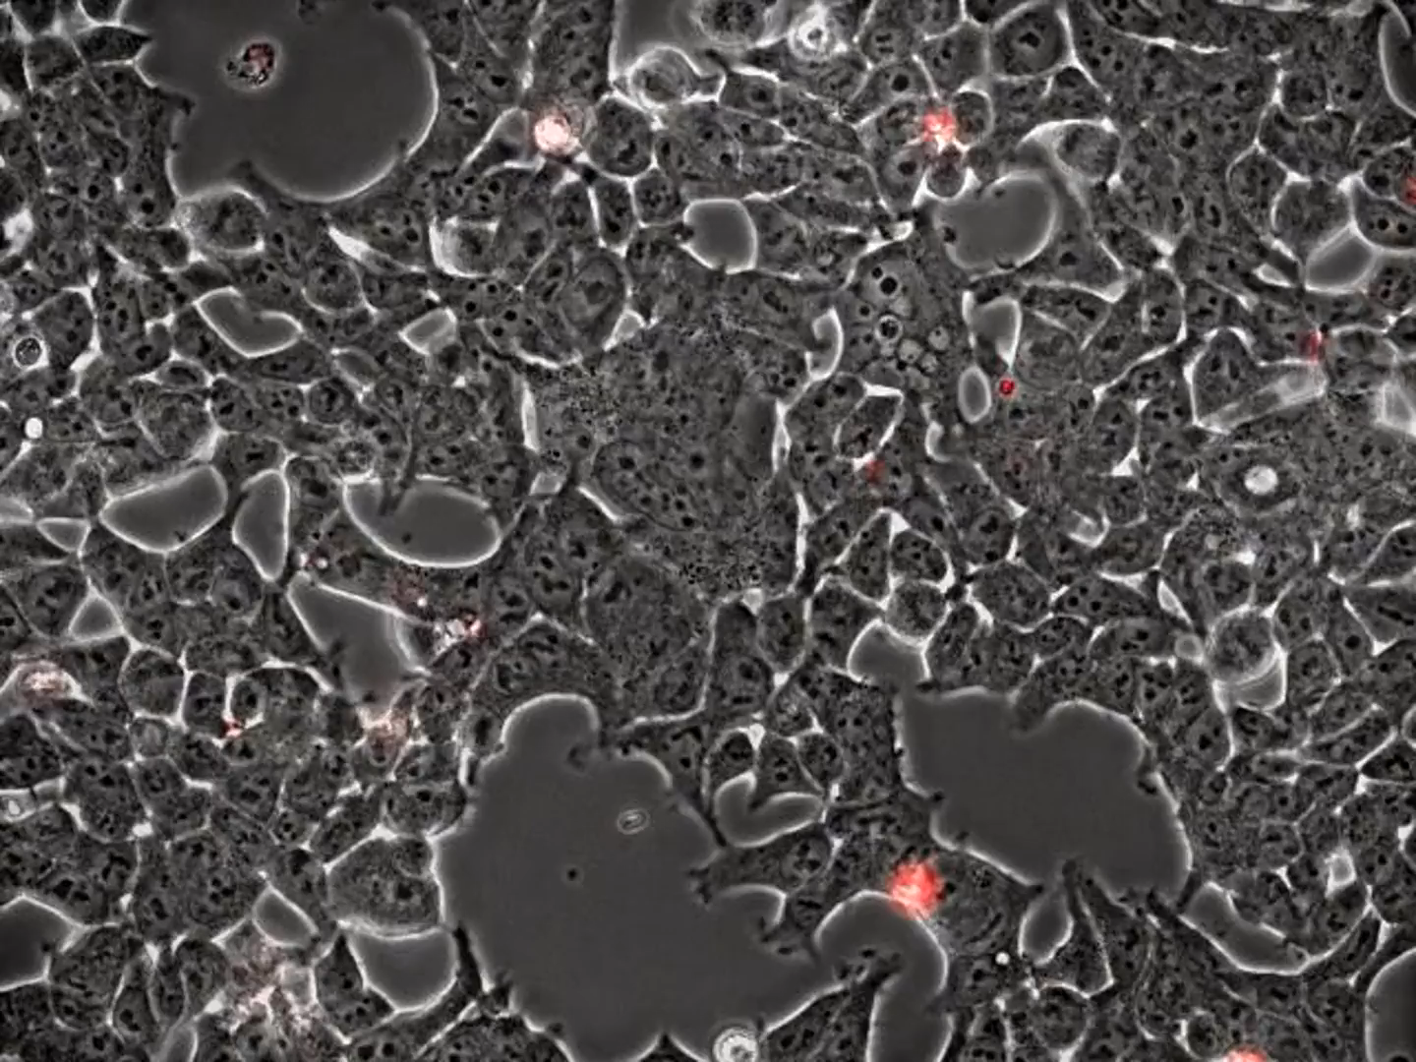
Fluorescence Microscopy to visualize the cellular processes
Seeing is believing
TF-Halo-JF646
5 µm
How cell divides and chromosomes
Segregate?
How SARS-CoV-2 causes cell fusion
and death in bat brain cells?
HeLa cells stained for DNA (blue), microtubules (green) and F-actin (red)
Single-Molecule Imaging of
transcription factor (TF)
in human cell nucleus
Mouse retina, confocal 3D microscopy: https://youtu.be/Jo7MvM_IXa8
3D imaging of collagen fibre network: https://youtu.be/pof6ywsTK6Y
Kidney cells mitosis: https://youtu.be/ed6OkXi6M5Q
Zebrafish embryonic development at single-cell resolution: https://youtu.be/RQ6vkDr_Dec
Notes:
Movie was provided by Zachary Swider, University of Wisconsin-Madison, USA. These are starfish cells in a developing embryo, they are at the blastula stage of development in this movie. The microtubules are labeled with 3xGFP-EMTB (Ensconsin Microtubule Binding Domain) and the DNA is labeled with mCherry-Histone H2B. The frames were originally captured at 18 sec/frame and the movie plays at 15 fps, so it's about 270x speed. The whole field of view is about 250 microns.
A microscopic video shows the coronavirus causing cell fusion and death in bat brain cells. (https://www.nytimes.com/2021/08/22/science/microscopic-bat-brain-virus.html)
HeLa cells stained for DNA (blue, Hoechst44432), microtubules (green, anti-tubulin, alpaca anti-mouse-alexa 488) and F-actin (red, phalloidin-Abberior STAR Red). Acquired with multiplex mode of Zeiss Airyscan.

Slide 18
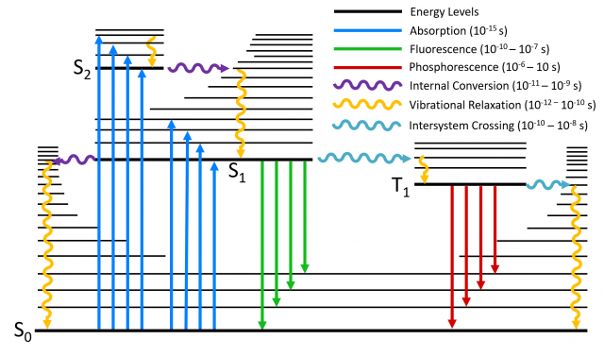
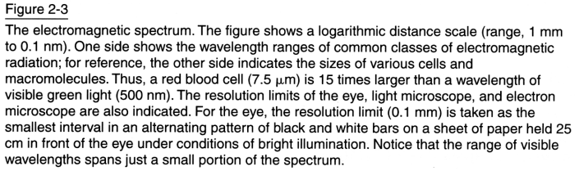
What is fluorescence?
Fluorescence is the emission of light by a molecule that has absorbed light.
Fluorescence has higher wavelength than absorbed light.
Jablonski diagram

Slide 19
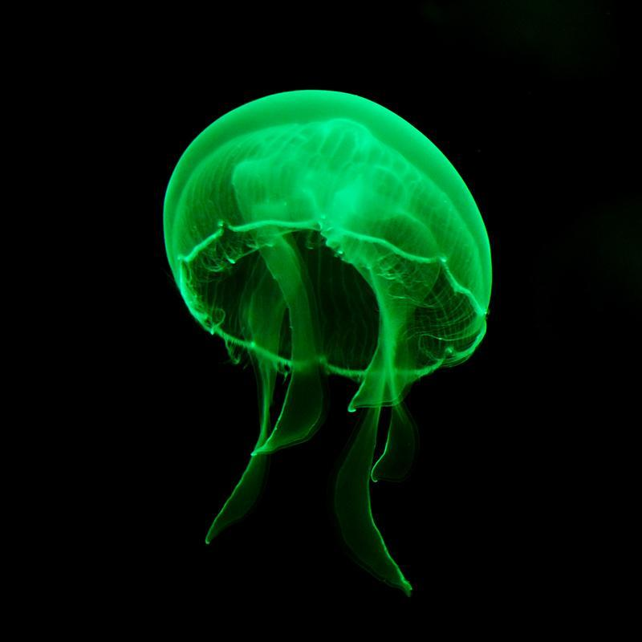
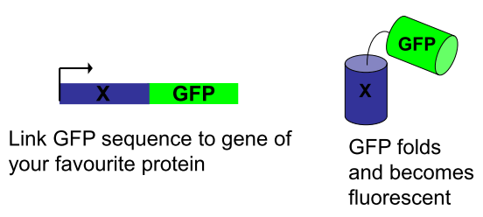
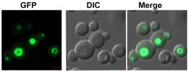
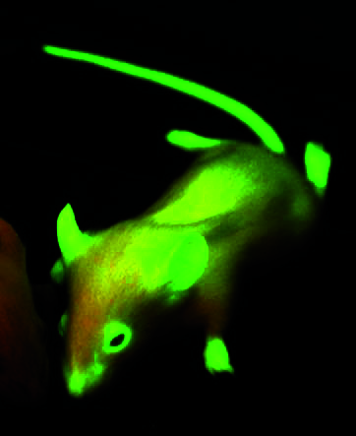
Discovery of Green Fluorescent Protein (GFP) leads to revolution in fluorescence microscopy
The prospects of fluorescence microscopy changed dramatically with the discovery of fluorescent proteins in the 1950s.
GFP was first discovered in the jellyfish Aequorea victoria.
Nobel prize awarded to Roger Tsien, Osamu Shimomura and Martin Chalfie in 2008 for their discovery of GFP.
Fluorescence due to three amino acids at positions S65, T66, G67.
Major excitation peak at 488 nm (blue light)
Emission peak is at 510 nm (green light)
Molecular weight ~27 kD
Amino Acids: 238
Green Fluorescence Protein (GFP)
488 nm
510 nm
Aequorea victoria jellyfish
Yeast cells expressing GFP labelled protein
Notes:
S= Serine, T=Threonine, E=Glutamate

Slide 20
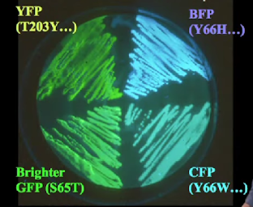
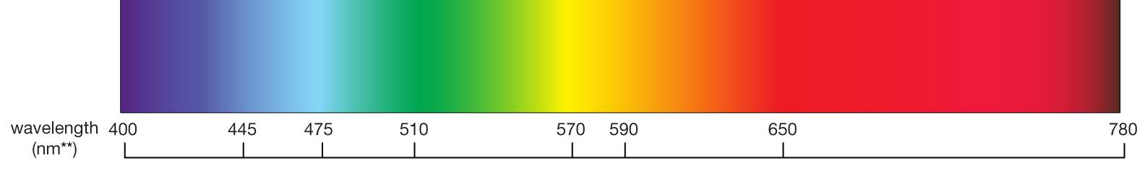
Protein engineering to change the spectral and physical properties of GFP
EGFP: S65T mutation leads to five times brighter GFP than original GFP. Ex: 488 nm, Em: 510 nm
Sapphire: T203I mutation leads to change in excitation and emission. Ex: 399 nm, Em: 511 nm.
BFP (Blue Fluroescent Protein): Y66H, Ex: 380 nm, Em: 448 nm
CFP (Cyan Fluorescent Protein): Y66W, Ex: 433/445 nm, Em: 475/503 nm
YFP (Yellow Fluroescent Protein): T203Y, Ex: 514 nm, Em: 527 nm
GFP and its variants covered the entire lower wavelength spectra of the visible light.
Red FPs are missing.
Colors of GFP mutants expressed in E. coli
https://www.leica-microsystems.com/science-lab/fluorescent-proteins-introduction-and-photo-spectral-characteristics/
Notes:
S=Serine; T=Threonine, I=Isoleucine, Y=Tyrosine, H=His, W=Tryptophan

Slide 21
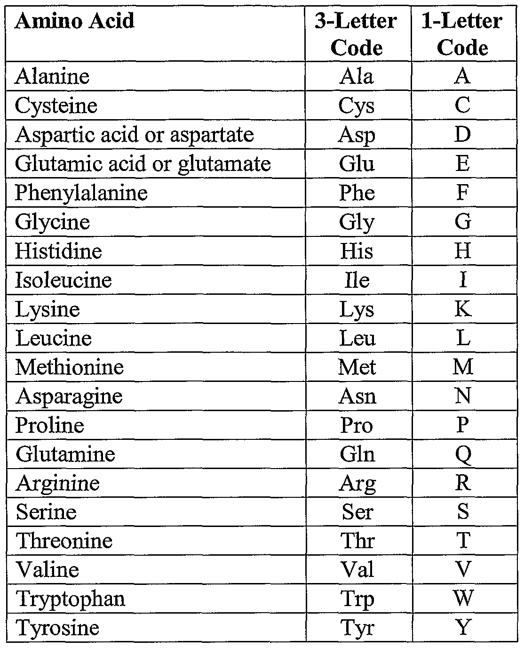

Slide 22
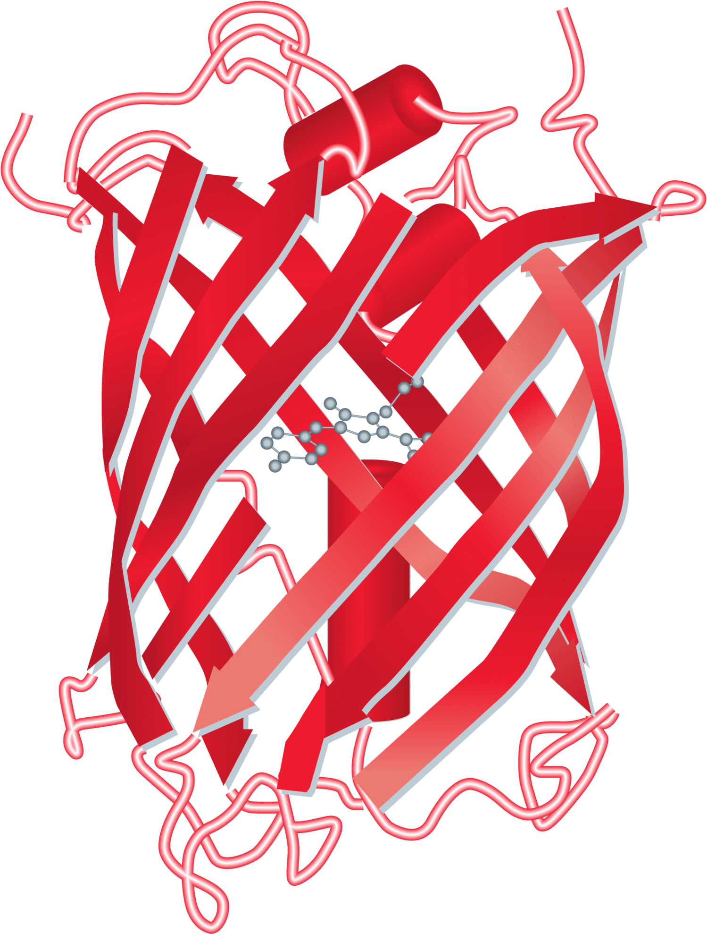
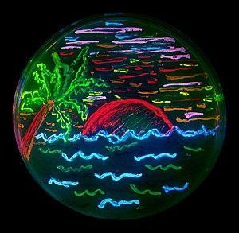
Fluorescent Proteins from Anthozoa (Red spectrum)
Russian scientist Sergey Kukyanov discovered Red Fluorescent Protein (RFP) in Anthozoa.
DsRed: Ex: 558, Em: 583.
DsRed2: Faster maturation and reduced oligomerization.
mRFP1: first monomeric RFP
Further genetic manipulations to mRFP1 leads to six mFruit FPs (mHoneydew, mBanana, mOrange, mTangerine, mStrawberry, mCherry).
mCherry is widely used: Em: 610 nm, brightness 50% of EGFP
mPlum: Em: 649 nm (Red FP with highest emission wavelength)
mKate2: Em: 635 nm (Brightest Red FP)
The diversity of genetic mutations is illustrated by living bacteria expressing 8 different colors of fluorescent proteins (derived from GFP and dsRed).

Slide 23
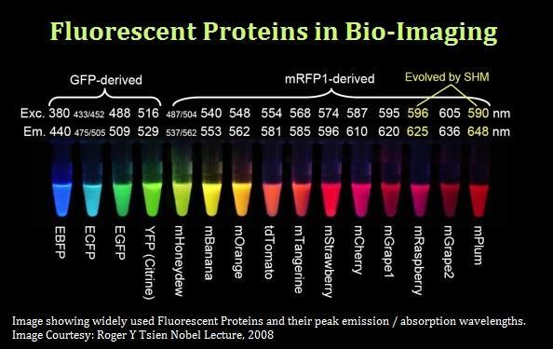

Slide 24
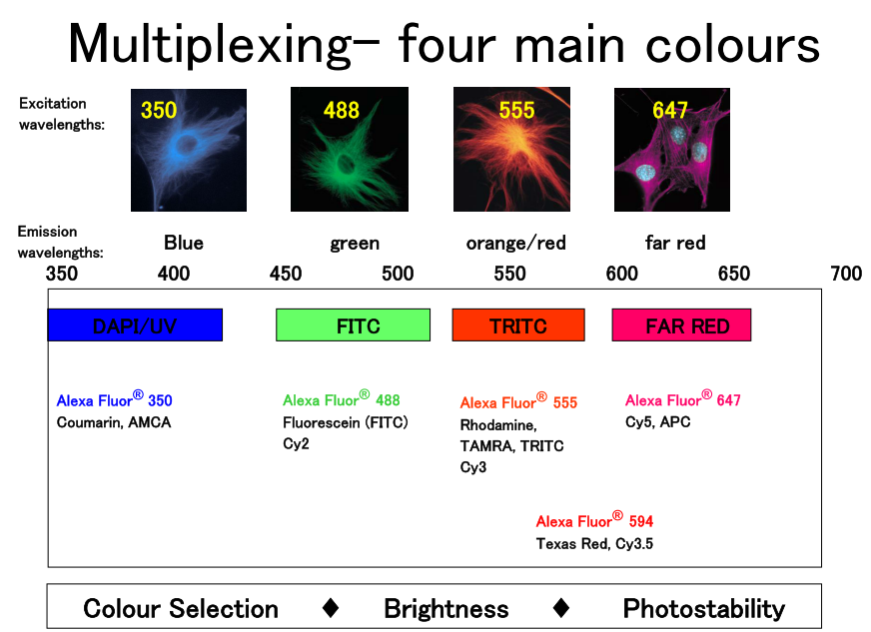
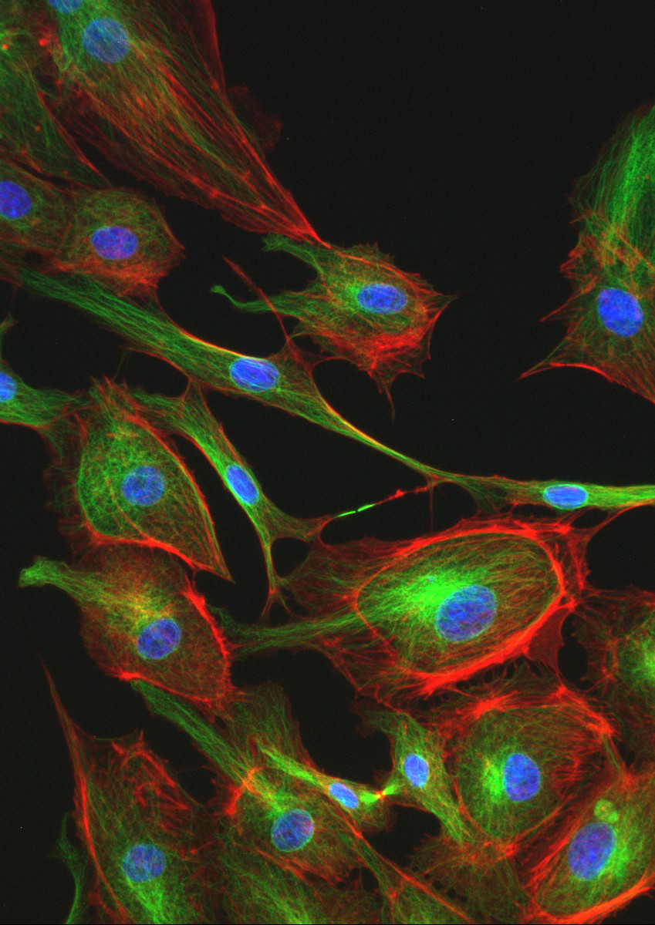
Blue: DAPI stained cell nucleus
Green: GFP labelled tubulin protein
Red: RFP labelled actin protein

Slide 25
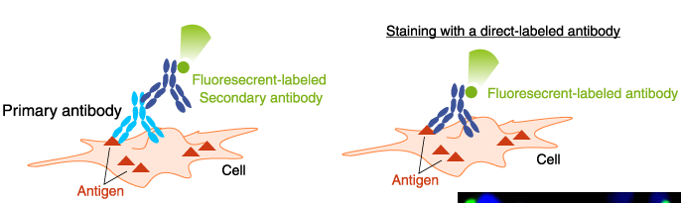
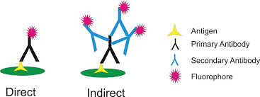
Strategies for labelling proteins with fluorescence
Genetic encoding: C-terminal or N-terminal fusion of a gene of interest with a gene of fluorescent protein.
Antibody based detection:
Gene X
GFP
C-terminal fusion
N-terminal fusion
Pros: Specificity of labeling, essential for live cell imaging
Cons: Time required for genetic engineering
GFP
Gene X
(Immunofluorescence, immunohistochemistry)
Pros: No genetic engineering is required if antibody is
available commercially. So, less time consuming.
Cons: suitable for fixed cells (not for live cells)
Non-specific binding may occur.

Slide 26
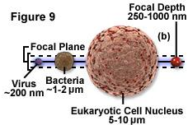
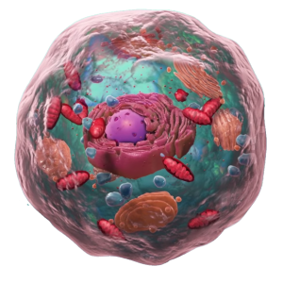
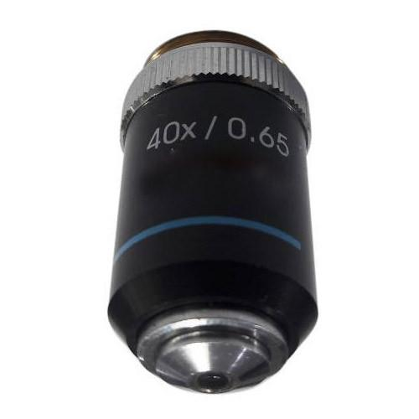
A cell is a 3D structure, so it should be imaged in 3D
Epifluorescence
(wide field illumination)
Cell
Z-stacking
Z steps= 5
Focal plane
Glass slide
Objective lens
Ideal Image
Actual 2D Image
MIP 3D Image
MIP=Maximum Intensity Projection

Slide 27
Further reading
Book: Fundamentals of Light Microscopy and Electronic Imaging by Douglas Murphy and Michael Davidson, 2nd edition, Wiley-Blackwell publisher, eBook ISBN 9781118382912
Book: Fluorescence Microscopy: From Principles to Biological Applications by Ulrich Kubitscheck, 2nd edition, John Wiley & Sons publisher, eBook ISBN 9783527687725
e-resource: https://www.microscopyu.com/
e-resource: https://www.ibiology.org/online-biology-courses/microscopy-series/
e-resource: http://zeiss-campus.magnet.fsu.edu/index.html
e-resource: https://www.leica-microsystems.com/science-lab/topics/basics-in-microscopy/
e-resource: https://www.olympus-lifescience.com/en/microscope-resource/
e-resource: https://imagej.nih.gov/ij/docs/examples/index.html
e-resource: https://www.youtube.com/playlist?list=PL5ESQNfM5lc7SAMstEu082ivW4BDMvd0U

Slide 28
Slide no. 29 onwards are not a part of your syllabus for the exam on 17/11/2025.

Slide 29






Bright field / Dark Field / Phase Contrast Microscopy

Slide 30



Anatomy of the Fluorescence Microscope
https://www.olympus-lifescience.com/en/microscope-resource/primer/techniques/fluorescence/anatomy/fluoromicroanatomy/

Slide 31

Fluorescence Recovery After Photobleaching (FRAP) to study protein dynamics
FRAP was established by Axelrod et al. (1976) to study protein mobility/dynamics in living cells.
It can be used to measure the diffusion dynamics of proteins in live cells.
POI=Protein of Interest
Photobleaching
using high
laser power
Recovery Time
POI-GFP
50 s
100 s
150 s
Fast
diffusing
protein
50 s
100 s
150 s
200 s
250 s
Slow
diffusing
protein

Slide 32


Immobile fraction
τ_{1/2}
Mobile fraction: fraction of fluorescent protein diffusing into bleached region during the time course of the experiment.
Immobile fraction: fraction of immobile bleached molecules within the bleach spot that don’t allow fluorescent molecules to occupy their space.
Aggregation of proteins, binding and diffusional barriers reduces mobile fraction.
Diffusion coefficient: Rate of movement of proteins

Slide 33



Fluorescence Resonance Energy Transfer (FRET) to study protein-protein interactions
Forster or Fluorescence Resonance Energy Transfer (FRET) is a mechanism describing energy transfer between two light-sensitive molecules (chromophores).
A donor chromophore in its excited state, transfer energy to an acceptor chromophore through nonradiative dipole-dipole coupling.
The efficiency of this energy transfer is inversely proportional to the 6th power of the distance between donor and acceptor, making FRET extremely sensitive to small change in distance (within 1-10 nm).
FRET is used to check protein-protein, protein-DNA interactions and protein conformation dynamics.
Donor
Acceptor

Slide 34


Single-Molecule Imaging to study protein dynamics
Single-Molecule Imaging (SMI) is a method of visualizing and quantifying the dynamics of the biomolecules at the single-molecule level, either in-vivo or in-vitro.
Classical biochemical/microscopy methods (such as IF, Western Blot, ChIP, Proteomics, FRAP etc.) describe the average behavior of biomolecules from 1000s of cells/1000s of molecules within a cell.
Such methods don’t allow the identification of subpopulations of biomolecules.
SMI visualizes the activity of single-molecules and record it with high spatiotemporal resolution.
Transcription factor binding to chromatin
Histone H2B binding to chromatin
Biological processes are highly dynamic.
e.g. phosphorylation, transcription factor binding
Cell nucleus
Cell nucleus
Western blot
(phospho-x)
Mass spec
(stoichiometry)
5 µm

Slide 35







Single-Molecule FISH to quantify number of mRNA/cell
To visualize single-molecules of mRNA in fixed cells
mRNA
CUP1 mRNA
PP7 mRNA (GFP)
Nuclei (DAPI)
Merged
5 µm
smFISH
Quantification of transcription by smFISH and RT-qPCR
mRNA
DAPI
Active cells
Wild-type
RT-qPCR
Relative gene expression
Inactive cells
Mutant
Wild-type
Mutant
5 µm
Number of cytoplasmic mRNA per cell

Slide 36

Optical Tweezers to measure biological forces
Optical tweezers use tightly focussed light beam (IR laser) to hold and manipulate microscopically small objects.
Microscope objective lens (high NA) is used for tight focussing of the IR laser beam. This region becomes an optical trap that can hold small objects in 3D.
Optical tweezers can also make accurate measurements of the sub-picoNewton forces exerted on the trapped objects and the small displacements (nanometer).
Since the diameter of biomolecules is generally between 1 and 10 nanometers, the optical tweezer cannot directly observe and manipulate. Hence, it is necessary to connect the molecule to the microspheres (beads) and indirectly manipulate and measure by using the beads as the “handle” of the manipulation. For example, the two ends of the DNA are connected to two beads, and the beads are manipulated by a double-beam tweezers to stretch the DNA and measure its elastic properties.
Optical tweezers have been used with great success in the field of single-molecule biophysics. For example, they have helped researchers unravel the complex elasticity and folding dynamics of DNA, RNA, proteins (especially motor protein dynamics) and other long-chain “biopolymers”.
Kimura and Bianco 2006, Analyst
https://physicsworld.com/a/optical-tweezers-where-physics-meets-biology/
https://en.wikipedia.org/wiki/Optical_tweezers

Slide 37



Strength of Kinetochore-Microtubule attachments
Figure 3.
(a) Diagram of a kinetochore-microtubule attachment under tension in an optical trap. (b)
Example rupture force measurement. The microbead returns to the center of the trap (zero
force) after the attachment ruptures. The peak force reached during the force ramp is the
“rupture force” that is recorded for that attachment.
(a) Diagram of a kinetochore-coated bead binding to a microtubule immobilized to a
coverslip through rigor kinesins. The blocking protein described in the text is 6xHis-GFP,
but any protein that has a 6xHis tag and that does not stick to the surface will work. (b) DIC
image of kinetochore beads bound to a microtubule mat.
Driver et al. 2014_Methods in Enzymology

